Slide 1
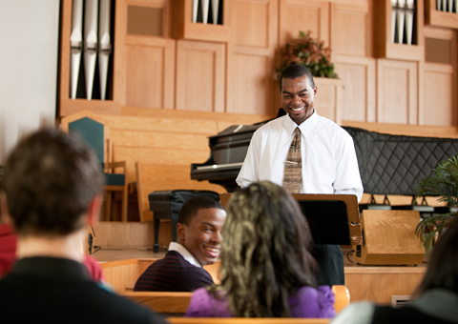
Notes:
Home page 1

Slide 2
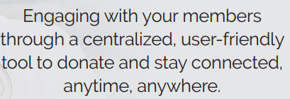
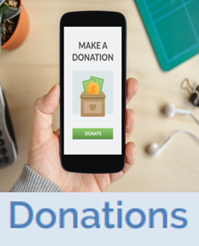

Slide 3
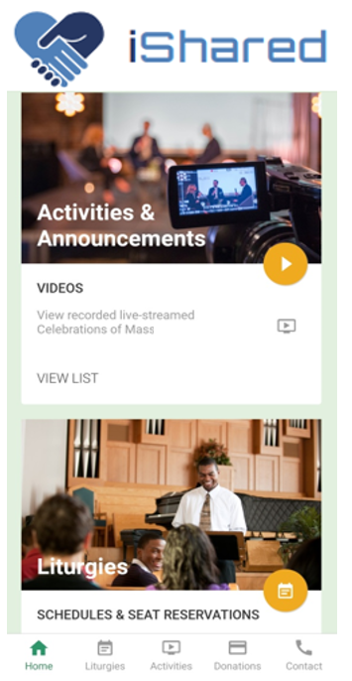
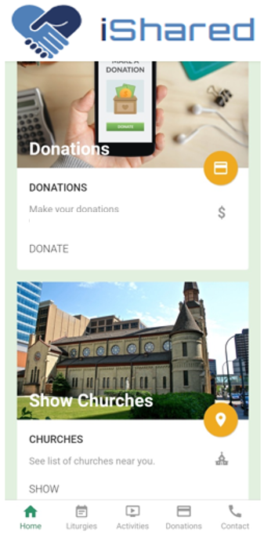
Notes:
Home page 1

Slide 4
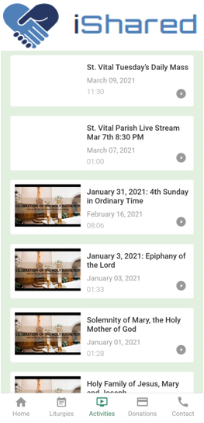
View Live-streamed gatherings and messages
Notes:
Activities page

Slide 5
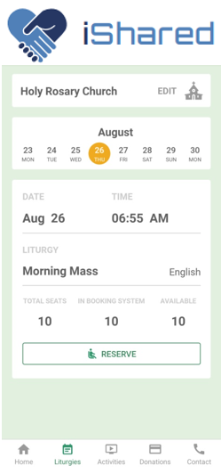
Book and make automated seat reservations
Notes:
Mass Reservation

Slide 6
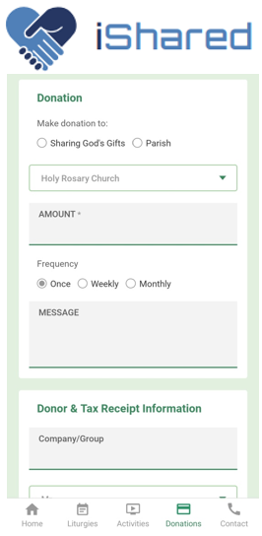
Recurring donations with instant tax receipts
Notes:
Donation page 1

